Slide 1
Methods for assessing physical performance, functional capabilities and human health 评估身体表现、功能能力和人体健康的方法
Book 3 ："Fundamentals of methodological and scientific research on physical culture and sports at the university”

Slide 2
1、Assess aerobic capacity 评估有氧能力
Energy metabolism during human exercise includes anaerobic metabolism and aerobic metabolism. Depending on the strength and duration of physical activity, the proportion of these two supply mechanisms is different. Usually a short period of intense exercise, mainly by anaerobic metabolic energy supply, long-term exercise, mainly aerobic metabolic energy supply
人体运动时能量代谢包括无氧代谢和有氧代谢。根据身体活动的力量和持续时间，这两种供应机制所占比例不同。通常短时间的剧烈运动，主要由无氧代谢供能，长时间的运动，主要是有氧代谢供能

Slide 3
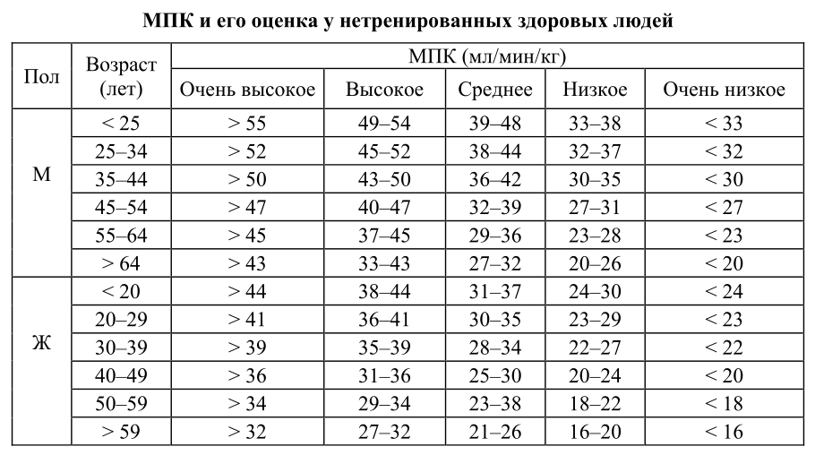
During the test, the subject‘s gender, age, physical health must be taken into account and monitored on an ongoing basis. The figure below is a comparison of the values measured using indirect methods. 在测试的过程中，必须考虑被试者的性别，年龄，身体健康状况并持续监控。下图是使用间接方法测量的数值对比图。

Slide 4
2、Assess anaerobic capacity 评估无氧能力
At its most intense exercise, oxygen demand greatly exceeds oxygen intake, and muscles produce energy through anaerobic metabolism, resulting in a loss of oxygen in the body. Maximum oxygen loss accumulation refers to the difference between the theoretical oxygen demand and actual oxygen consumption of the project when the human body is engaged in extreme intensity exercise (generally 1-3 minutes of continuous exercise). It is an important index to evaluate anaerobic energy supply capacity. After completion of the work, the excess oxygen consumption is measured compared to the rest of M1 / min or mL / min / kg. 最剧烈运动时，需氧量大大超过摄氧量，肌肉通过无氧代谢产生能量造成体内氧亏。最大氧亏积累是指人体从事极限强度运动时（一般持续运动1-3分钟），完成该项目运动的理论需氧量与实际耗氧量之差。是评价无氧供能能力的重要指标。在完成工作之后，将过量的氧气消耗与M1 / min或mL / min / kg的其余部分相比测量。
Notes:
Tips：30-45分钟，在计算最大氧亏的基础上，记录10-15个值的组合。20-35岁成年男性非运动员的最大氧亏通常不超过70-110ml/kg。随着年龄的增长，每年下降1%左右。女性的最大氧亏比男性平均低30-40%。
30-45 minutes to record a combination of 10-15 values on the basis of calculating the maximum oxygen loss. The maximum oxygen loss for non-athletes of adult males aged 20-35 years is usually no more than 70-110 ml/kg. As you get older, it decreases by about 1% a year. Women's maximum oxygen loss is 30-40% lower than men's on average.

Slide 5
3、Assess physical abilities 评估身体能力
Physical conditions include: A, health; B, physiology; C, physiological function.
身体状况包括：
A、健康；B、体格； C、生理功能状态。
Equipment required to assess fitness levels: A, stopwatch; B, scale; C, height meter;
D, blood pressure meter
评估体能水平需要的器材：
A、秒表； B、体重秤； C、身高仪；D、血压计
Formula for calculating physical abilities: UFS (700 - 3 CSU - 2.5 ADSR - 2.7 B q 028 m ) / (350 - 2.6 B q 0.21 h)
计算身体能力的公式：
УФС = (700 – 3 ЧСС – 2,5 АДср – 2,7 В + 028 m ) / (350 – 2,6 В + 0,21 h)
Among them, HR is resting heart rate in minutes; BP is 1/3 of the difference between average arterial pressure (the total of throestric pressure) and systolic pressure and espressure. A is blood pressure; B is age (years); m is weight (kg); h is height (cm). 其中HR为静息心率，单位为分钟； BP是平均动脉压(舒张压之和) +收缩压和舒张压之差的1/3。
A是血压；B是年龄（岁）；m是体重（公斤）；h是高度（厘米）。
Notes:
Tips：健康（重要活动年龄规范的指标规范和生物体的可持续性程度对不利外部影响）
Health (indicator specifications for age norms for important activities and adverse external impacts on the sustainability of organisms)

Slide 6
4、Harvard Ladder Test 哈佛阶梯测试
Formula: IGST - 100t / 5.5n（公式：IGST = 100t / 5.5n）
其中t是上升时间（以秒为单位）；n是从恢复的第二分钟开始的前30个 心跳数。
Harvard Ladder Test Index (IHST) The rising speed is 30 cycles per minute. Men's steps are 50 cm high and women's 43 cm, and since a cycle consists of 4 steps, the speed of the beater is set to 120 per minute. Fatigue begins to lag behind the set speed during the as rise, then stop the test after 15-20 s and record the actual working time in seconds. When there are external signs of excessive fatigue: pale face, tripped, etc., the test will also stop. After completing the work, the subjects sat in a chair and calculated their heart rate from the first 30 seconds of recovery. 哈佛阶梯测试指数（IHST）
上升速度为每分钟30个循环。男士步高50厘米，女性43厘米，由于一个周期由4个步骤组成，因此节拍器的速度设置为每 1分钟120个。在上升过程中出现疲劳并开始落后于设定的速度，则15–20 s后，停止测试，并以秒为单位记录实际的工作时间。当出现过度疲劳的外部迹象时：脸部苍白，绊脚等，测试也将停止。完成工作后，受试者坐在椅子上，并从恢复的第二分钟开始的前30秒计算心率。
Notes:
Tips：如果IGST低于55，低于平均水平为55-64，平均水平为65-79，良好为80-89，以及优异-90或更高，则身体机能被评估为较弱。If IGST is below 55, below average 55-64, average is 65-79, good is 80-89, and excellent -90 or higher, then physical function is assessed as weak.

Slide 7
5、Assess physical abilities based on the indirect definitions of the PWC170 test and IPC 根据PWC170测试和IPC的间接定义评估身体能力
PWC170(Physical Working Capacity)
The test measured the power of physical activity (in kg/min or W), and when working, the heart rate was set to 170 times per minute, the greater the strength, the better the level of cardiopulmonary function. 测试测定的是体力活动的功率(以kg/min或W表示)，工作起来后，心率设定为每分钟170次，力量越大，心肺功能水平越好。
Formula: All power W s hmnk（计算公式：所有功率 W = hmnk）
PWC170 Calculation Formula: PWC170 s W (170-HR1)/(HR2 -HR1) PWC170计算公式：PWC170 = W（170-HR1）/（HR2 -HR1）
Using the data from the PWC170, the maximum oxygen consumption can be determined by the formula: IPC ml / min s 2.2PWC170 s 1070 使用PWC170的数据，可以确定最大耗氧量，公式为：IPC ml / min = 2.2PWC170 + 1070
Notes:
Tips：测试方法：在受试者以舒适的坐姿坐着休息几分钟后，开始。休息几分钟后，确定1分钟内的心率（HR1）。然后再上台阶2分钟。上升速度是恒定的，等于每1分钟25个循环（循环由上升计划中规定的4个步骤组成）。然后以每分钟25个循环的稳定速度开始（这包括4个步骤，节拍器要求的速度是100 bpm）。结束后，受试者坐下来，计算心率。恢复期头10秒内的心动次数。所得值在然后乘以6，计算出工作后的脉率（HR2）。
Test method: Start after the subjects sit comfortably and rest for a few minutes. After a few minutes of rest, determine the heart rate (HR1) within 1 minute. Then go up the steps for 2 minutes. The rate of as rise is constant, equal to 25 cycles per minute (the cycle consists of the four steps specified in the ass rise plan). It then starts at a steady speed of 25 cycles per minute (this includes 4 steps, and the beater requires a speed of 100 bpm). At the end, the subjects sat down and calculated their heart rate. Number of heartbes in the first 10 seconds of the recovery period. The resulting value is then multiplied by 6 to calculate the pulse rate (HR2) after operation.

Slide 8
6、6 minutes to test your body‘s abilities 6分钟测试身体能力
How to test: 1、calculate the subject‘s resting heart rate for 1 minute. 2、when the subjects get up, calculate the vertical position of the second minute heart rate. 3、The difference between standing and lying down has been multiplied by 10. 4、the subjects in 40 s to do 20 squats (squat when the arm vigorously forward, stand up and put down). The heart rate is calculated in the first minute of recovery. 5、restore the second minute to calculate the heart rate. 6、restore the third minute to calculate the heart rate. 测试方法：
1、计算被试者仰卧位静止心率1分钟。
2、被试者起来时，计算垂直位置的第二分钟心率。
3、站立和躺卧心率之差乘以10。
4、受试者在40 s内做20个深蹲（下蹲时手臂大力向前伸，站起时放下）。恢复的第一分钟的心率进行计算。
5、恢复第二分钟计算心率。
6、恢复第三分钟计算心率。
Notes:
Tips：将上述六个项目的结果相加，即为最终得分。总数500以上为 "低"，450-500为 "一般以下"，400-450为 "一般"，350-400为 "一般以上"，350以下为 "高"。
Add up the results of the six items mentioned above, i.e. the final score. The total number of more than 500 is "low", 450-500 is "general below", 400-450 is "general", 350-400 is "general above" and below 350 is "high".

Slide 9
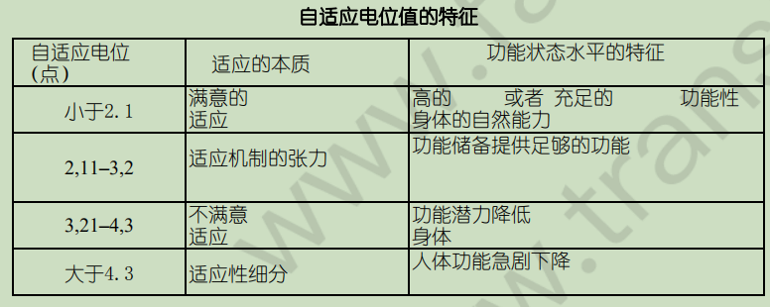
7、Determination of adaptability 适应能力的确定
To assess the potential for adaptation, blood pressure and heart rate levels are measured. The value of the indicator is determined by the formula below. AP = 0.011HRC + 0.014SBP+ 0.008DBP + 0.014B + 0.009m - 0.009h - 0.27 为了评估适应潜力，测量血压和心率水平。通过下面的公式，确定指示符的数值。
AP = 0.011HRC + 0.014SBP+ 0.008DBP + 0.014B + 0.009m - 0.009h - 0.27
Among them, HR is heart rate, units are min; SBP and DBP are systolic and lysus, respectively; B is age, years old; m is weight, units are kg; h is height, units are cm.
其中HR为心率，单位为min；SBP和DBP分别为收缩压和舒张压；B为年龄，单位为岁；m为体重，单位为kg；h为身高，单位为cm。

Slide 10
8、Comprehensive assessment 综合评估
A comprehensive quantitative assessment of physical health can be done by recording indicators (physiological, anthophysical, and physical) and then summarizing them into a general score (3). To estimate physical fitness levels, the pulse recovery time after height, weight, lung capacity (VCL), resting pulse (HR), hand strength, systolic blood pressure level (BPa), and functional tests (30 seconds of 20 squats) was taken into account. 对身体健康的综合量化评估可以通过记录一些指标（生理、人体测量和体能），然后将其归纳为一个概括性的分数来进行（3）。为了估计身体健康水平，考虑到了身高、体重、肺活量(VCL)、静息脉搏(HR)、手部力量、收缩压水平(BPa)和功能测试(20次下蹲30秒)后的脉搏恢复时间。

Slide 11
Thanks for your attention
Shang Mingjunke
Peng Xiaoying

